Slide 1


Dept. of Computer Science & Engineering.
Unit No 1
Introduction to Human-Computer Interaction
Prepared By:
Prof. A. R. Uttarkar
Assistant Professor
CSE Department, MIT SOE
PLD

Slide 2
Unit -1 at a Glance
Unit-I: Introduction to Human-Computer Interaction
Includes the difference between good and poor interaction design What interaction design is and how it relates to human-computer interaction and other fields What is involved in the process of interaction design, the different forms of guidance used in interaction design, etc. Need for Design - Examples from Design of everyday things, case studies, Evolution of the web and digital interfaces, Design thinking and wicked problems. Exercise - Identify problems around us requiring design solutions Or problems solved using design.

Slide 3
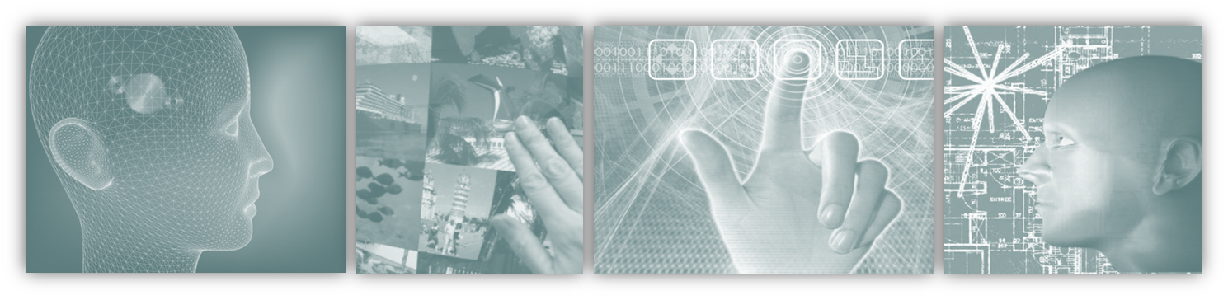
By the end of this chapter, you will…
Understand the difference between good and poor interaction design.
Be able to describe what interaction design is and how it relates to human-computer interaction and other fields.
Understand what is meant by the user experience and usability.
Understand what is involved in the process of interaction design.
Outline the different forms of guidance used in interaction design.

Slide 4

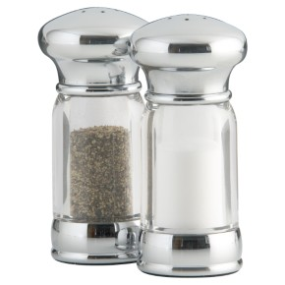
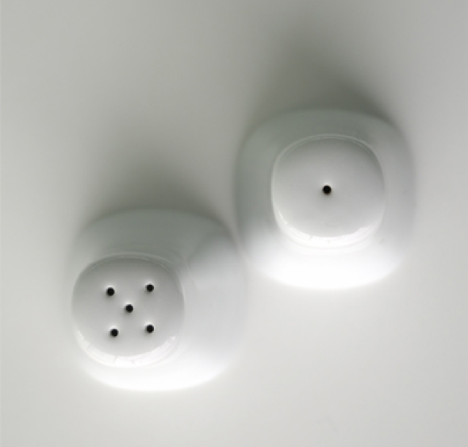
Good design makes a product useful. A product is bought to be used. It has to satisfy certain criteria, not only functional, but also psychological and aesthetic. Good design emphasizes the usefulness of a product whilst disregarding anything that could possibly detract from it.
Which do you think should have the most holes?
Image from http://www.jnd.org/books.html#608 :
Does it matter what the designers think?

Slide 5
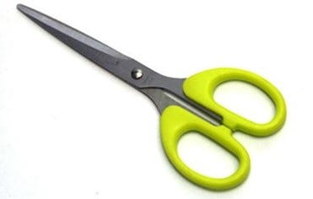
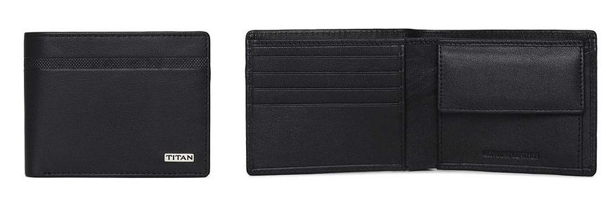
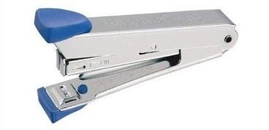
Good design is innovative.
•Good design makes a product useful.
•Good design is aesthetic.
•Good design makes a product understandable.
•Good design is unobtrusive.
•Good design is honest.
•Good design is long-lasting.
•Good design is thorough down to the last detail.
•Good design is environmentally-friendly

Slide 6
Definition of good design
Good design can be difficult to define, but in general it refers to the creation of aesthetically pleasing items that are also functional. Good design is often thought of as being visually appealing and creative, yet still able to fulfil its purpose whether it’s a piece of furniture or an app.
Designers strive to create products that meet these criteria by exploring elements such as shape, color, texture and size. It’s important for designers to consider usability factors when creating a product so that users can understand how the product works effectively without confusion or frustration.

Slide 7
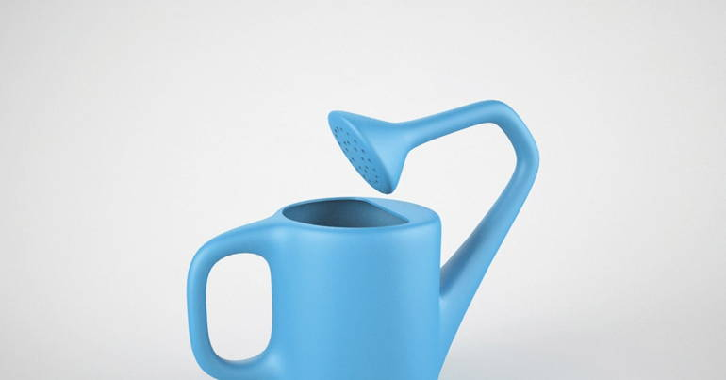
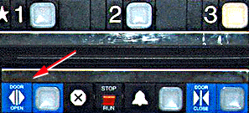
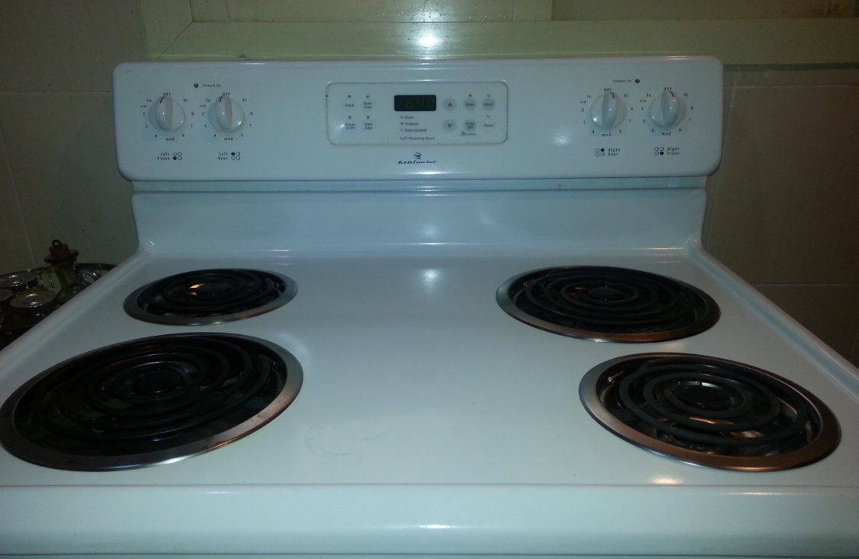
Bad Design
Elevator controls and labels on the bottom row all look the same, so it is easy to push a label by mistake instead of a control button
People do not make same mistake for the labels and buttons on the top row. Why not?

Slide 8
Definition of bad design
Bad design is an umbrella term used to refer to any design that fails to fulfil its intended purpose. Bad design can encompass a wide range of failures, from aesthetic issues such as poor color selection or a cluttered layout, to functional issues such as usability problems or difficulty navigating a website.
Bad design can also refer to designs that don’t effectively deliver their message, or are not appropriate for the intended audience. It can be difficult to define bad design since it’s often subjective and open to interpretation; however, some common indicators of bad design include confusing navigation systems, unreadable text, too-small elements on the page, overcomplicated designs with too much going on at once, and poorly designed visuals that fail to grab attention.

Slide 9
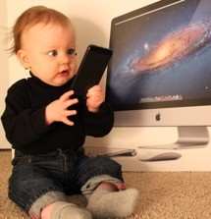

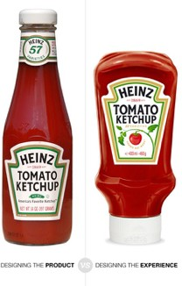
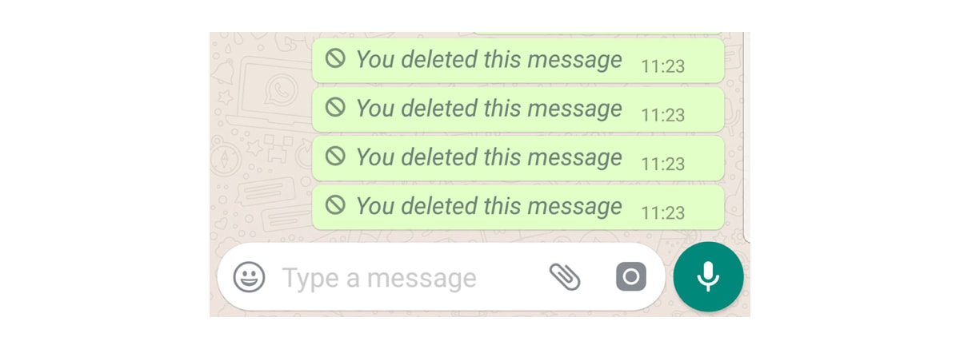
Good Vs Bad Design

Slide 10
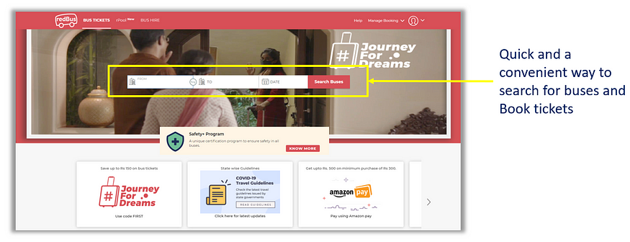
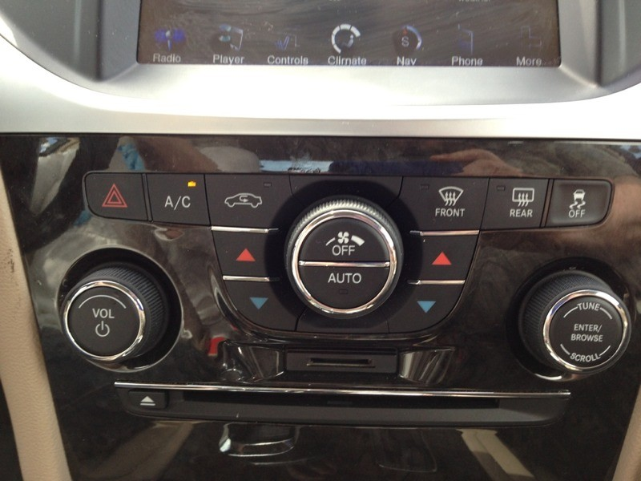

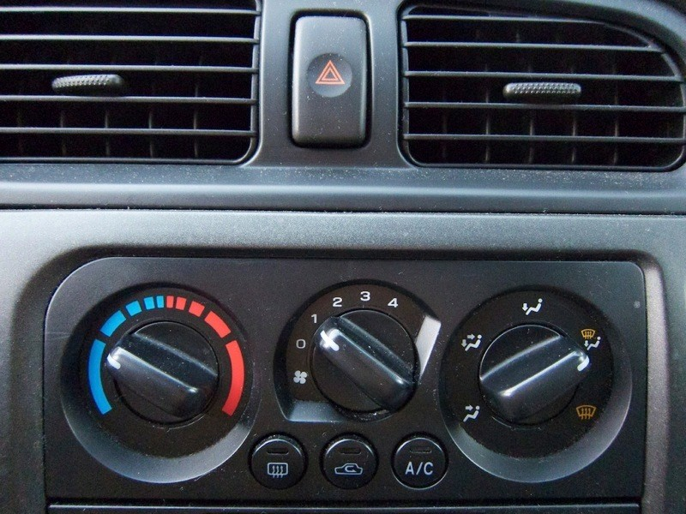

Slide 11
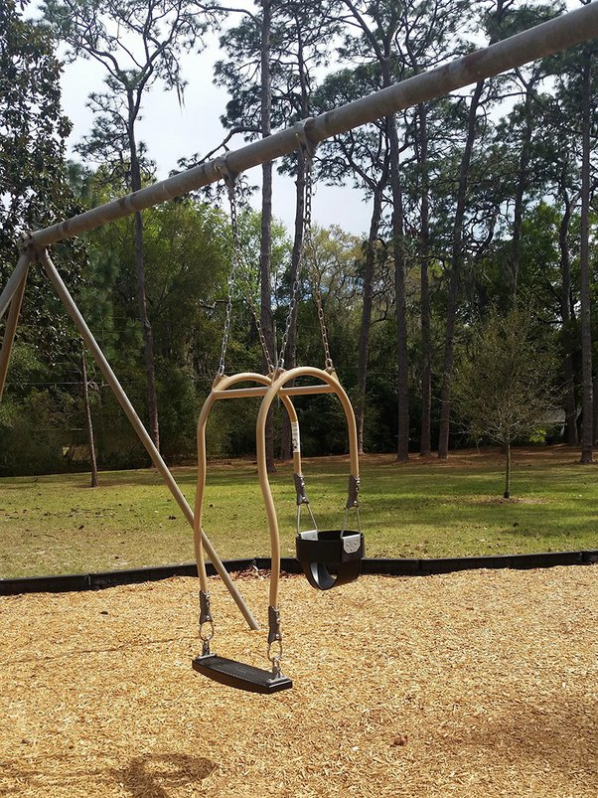
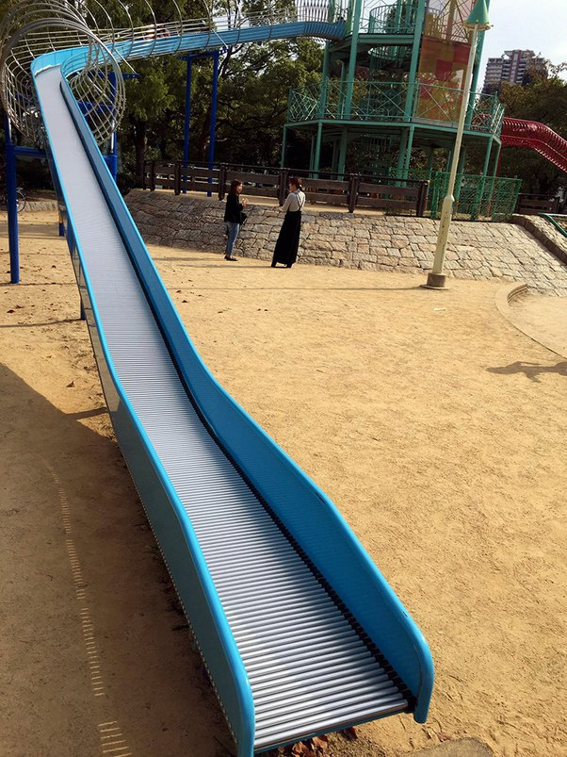

Slide 12
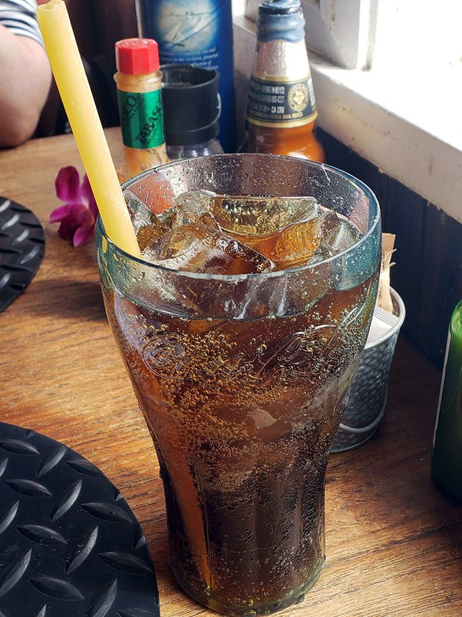
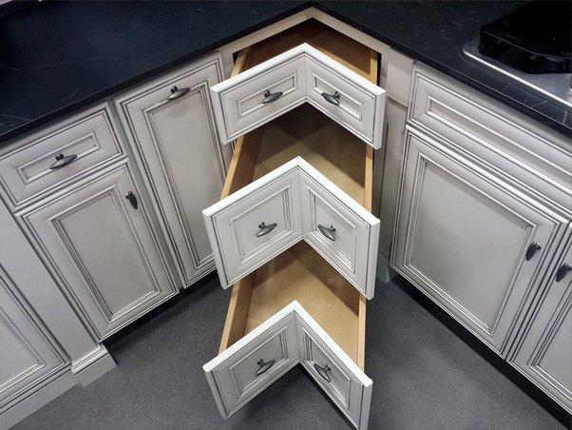
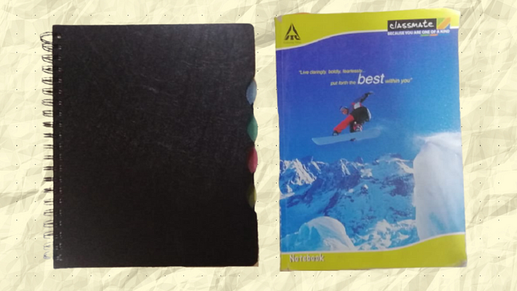
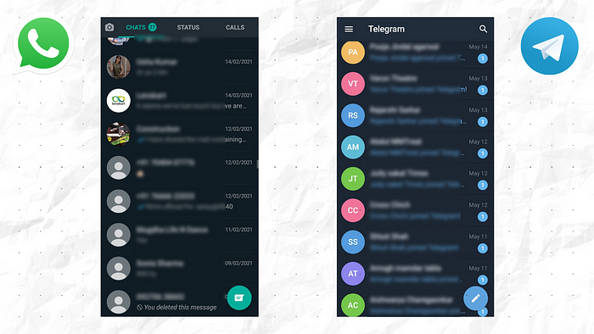
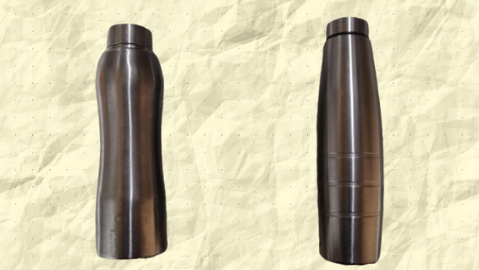

Slide 13
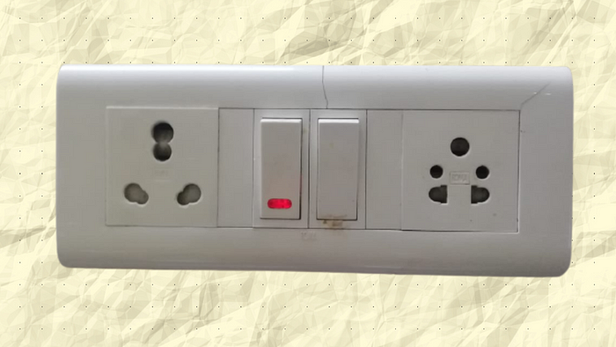
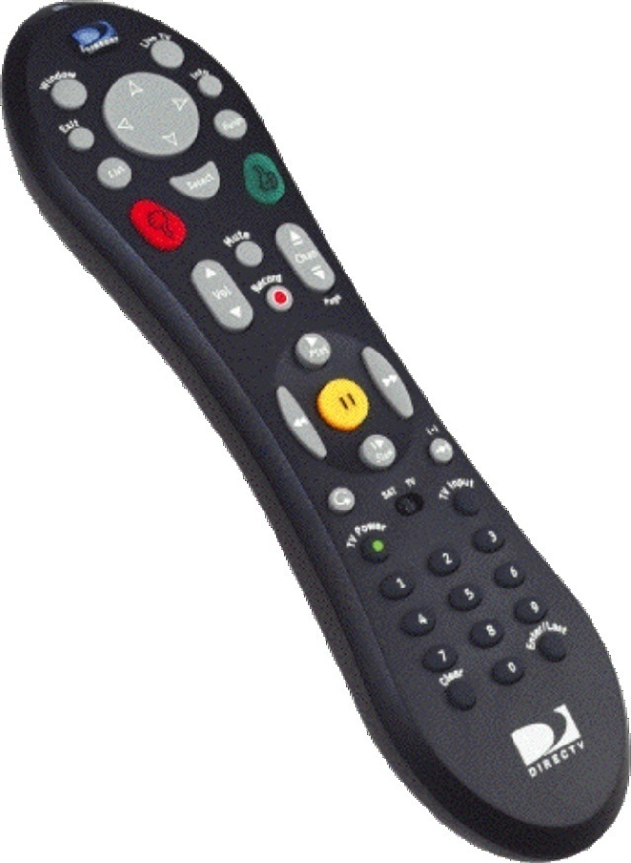
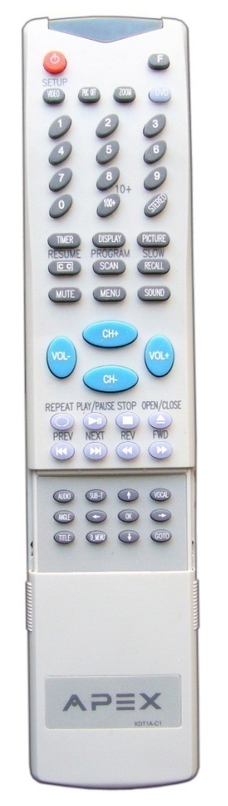
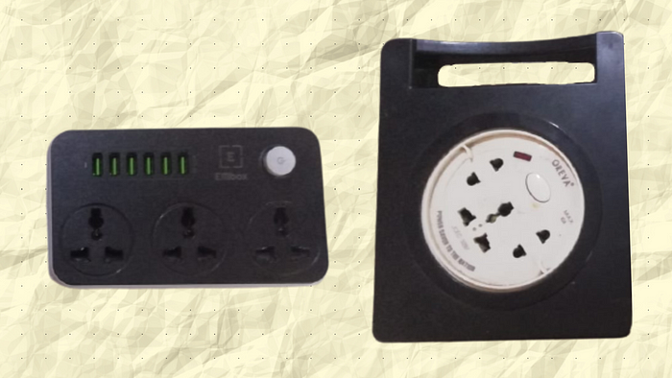
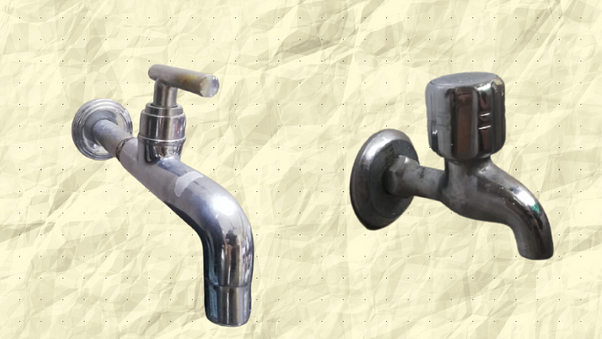

Slide 14
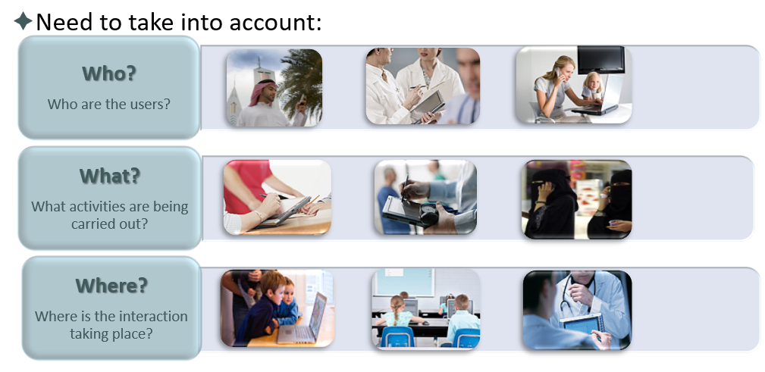
What to Design
Need to take into account what people are good and bad at
Consider what might help people in the way they currently do things
Think through what might provide quality user experiences
Listen to what people want and get them involved
Use tried and tested user-centered methods

Slide 15
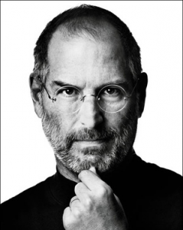
Steve Jobs legacy : HCI
Human-computer interaction (HCI) has always been at the heart of Apple design.
Jobs recognized the central role of the user as well as human-computer interaction and design in products.
Steve Jobs and Apple computers, by investing in products that are enjoyable easy to use by anyone, have changed the way that user experience is perceived in both technology and computer companies.
People working in the field of HCI often make a prime example of Apple products as a standard for a device that has good user experience, while also being commercially successful.
Steve quotes about Design : "the design that works". "Most people make the mistake of thinking design is what it looks like. People think it's this veneer - that the designers are handed this box and told, 'Make it look good!' That's not what we think design is. It's not just what it looks like and feels like. Design is how it works," (New York Times, November 30, 2003).

Slide 16
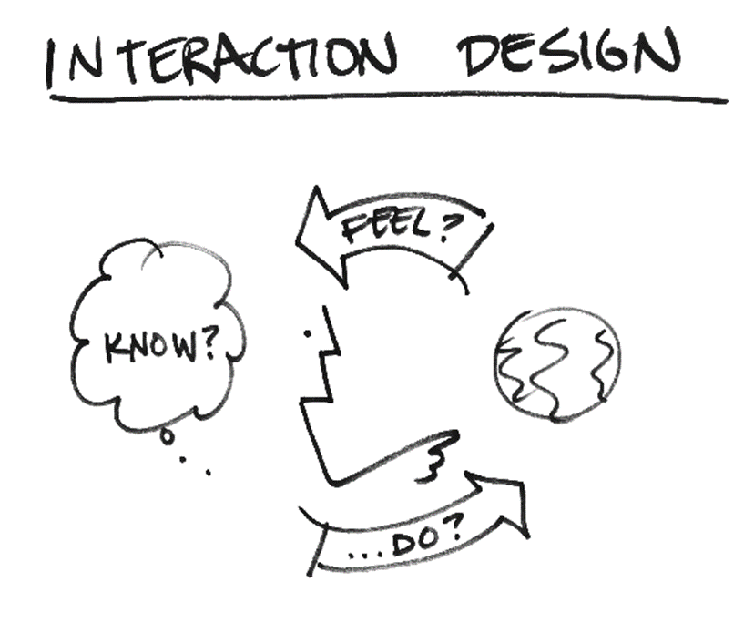
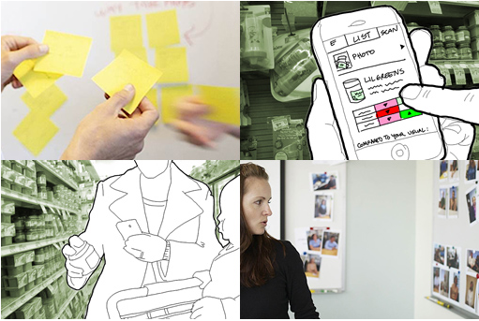
What is Interaction Design?
Develop usable products
Usability means
easy to learn,
effective to use and
provide an enjoyable experience
Involve users in the design process

Slide 17
Number of other terms used emphasizing what is being designed, e.g.,
user interface design, software design, user-centered design, product design, web design, experience design (UX)
Interaction design is the umbrella term covering all of these aspects
fundamental to all disciplines, fields, and approaches concerned with researching and designing computer-based systems for people

Slide 18
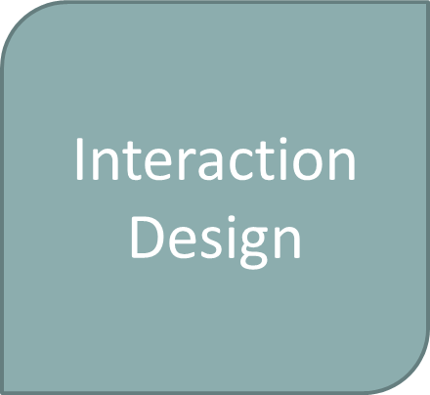
HCI and Interaction Design
Academic Disciplines
Design Practices
Computer Science/ Software Engineering
Graphic Design
Ergonomics
Product Design
Engineering
Artist Design
Psychology/
Cognitive Science
Industrial Design
Informatics
Film Industry
Social Sciences
Human Factors Engineering (HF)
Computer-Supported Cooperative Work (CSCW)
Human Computer Interaction (HCI)
Cognitive Engineering /
Cognitive Ergonomics
Information Systems (IS)
Interdisciplinary Fields

Slide 19
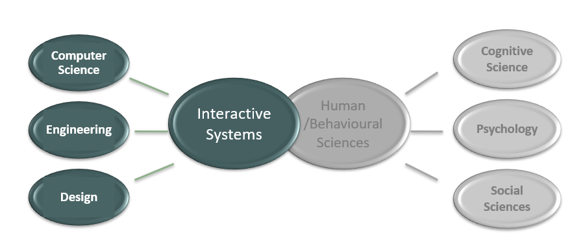
What is HCI?
Human-Computer Interaction draws on the fields of computer science, psychology, cognitive science, and organizational and social sciences in order to understand how people use and experience interactive technology.

Slide 20
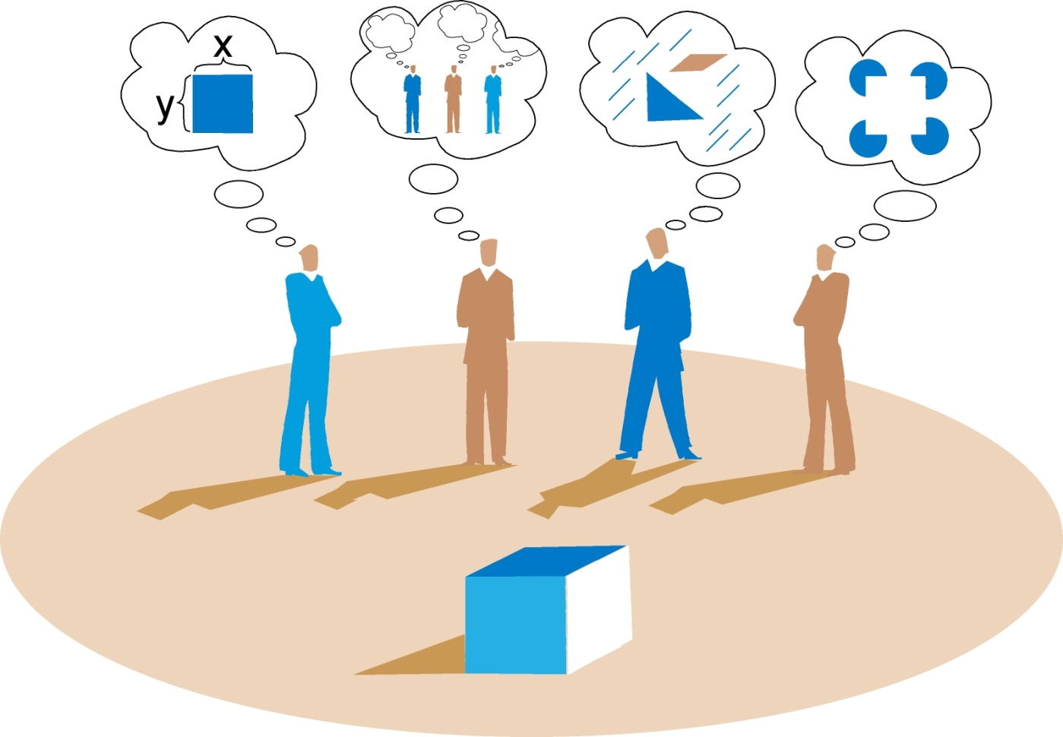
View design as a form of communication between designers and the users.
Different perspectives
 More ideas
 Challenge in communication and progressing forward
Different people/ ~ backgrounds

Slide 21
What do professionals do in the ID business?
interaction designers - people involved in the design of all the interactive aspects of a product
usability engineers - people who focus on evaluating products, using usability methods and principles
web designers - people who develop and create the visual design of websites, such as layouts
information architects - people who come up with ideas of how to plan and structure interactive products
user experience designers (UX) - people who do all the above but who may also carry out field studies to inform the design of products

Slide 22
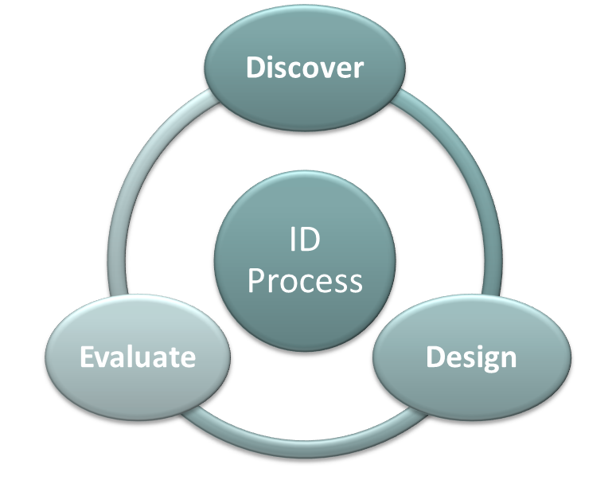
What is involved in the process of ID?
Discover
Identifying needs and establishing requirements for the user experience
Design
Developing alternative designs to meet these
Building interactive prototypes that can be communicated and assessed
Evaluate
Evaluating what is being built throughout the process and the user experience it offers

Slide 23
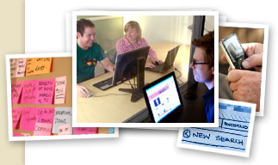
Core Characteristics of Interaction Design
Users should be involved through the development of the project
Specific usability and user experience goals need to be identified, clearly documented and agreed at the beginning of the project
Iteration is needed through the core activities

Slide 24
Why go to this length?
Help designers:
Understand how to design interactive products that fit with what people want, need and may desire
Appreciate that one size does not fit all
e.g., teenagers are very different to grown-ups
Identify any incorrect assumptions they may have about particular user groups
e.g., not all old people want or need big fonts
be aware of both people’s sensitivities and their capabilities

Slide 25





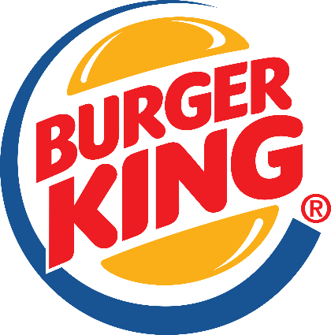

Are Cultural Differences Important?
5/21/1960 versus 21/5/1960?
Which should be used for international services and online forms?
Examples of websites that are reacted differently by people from different cultures?

Slide 26
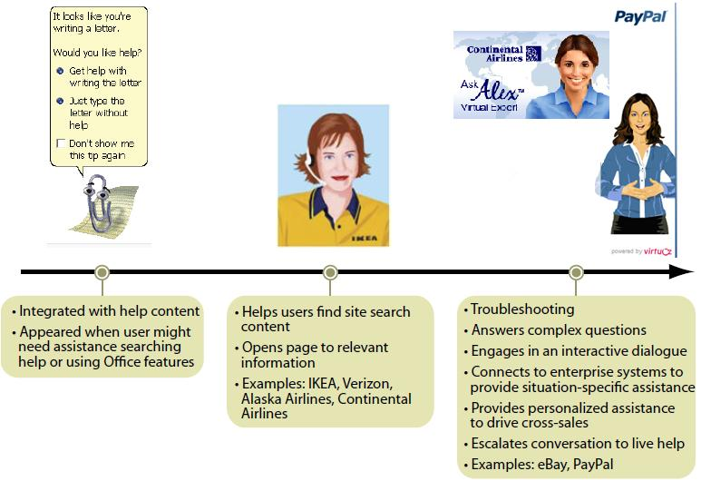
Virtual Agents, Avatars…
Virtual Agents, Avatars, ..

Slide 27
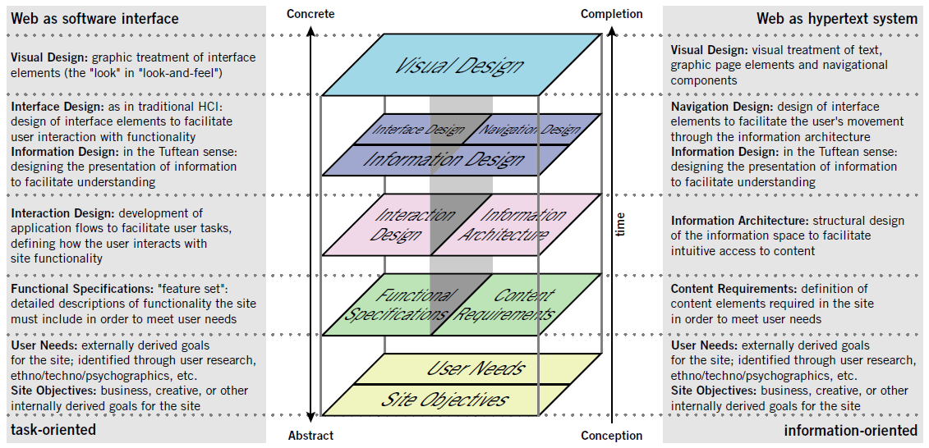
Elements of the User Experience (UX)
Virtual Agents, Avatars, ..

Slide 28
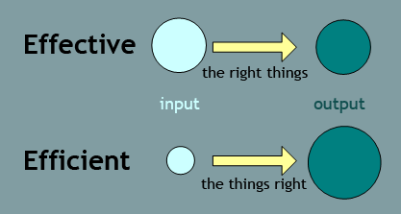
Usability Goals
Effectiveness: refers to how good a product is at doing what it is supposed to do. (the expected result)
Q: Is the product capable of allowing people to learn, carry out their work effectively, access the info they need, or buy the goods they want?
Efficiency: refers to the way a product support users in carrying their common tasks with the least waste of time and effort. (ex: online shopping, one-click option)
Q: Once users have learned how to use a product to carry out their tasks, can they sustain a high level of productivity?
Effective to use
Efficient to use
Safe to use
Have good utility
Easy to learn
Easy to remember how to use
Virtual Agents, Avatars, ..
Being effective is about doing the right things, while being efficient is about doing the things in the right manner..

Slide 29
Safety: involves protecting the user from dangerous conditions and undesirable situations.
Q: what is the range of errors that are possible using the product and what measures are there to permit users to recover easily from them?
Utility: refers to the extent to which the product provides the right kind of functionality so that users can do what they need or want to do. (ex: drawing tools)
Q: Does the product provide an appropriate set of functions that will enable users to carry out all their tasks in the way they want to do them?
Virtual Agents, Avatars, ..

Slide 30
Learnability: refers to how easy a system is to learn to use.
Q: is it possible for the user to work out how to use the product by exploring the interface and trying out certain actions? How hard will it be to learn the whole set of functions in this way?
Memorability: refers to how easy a product is to remember how to use, once learned.
Q: what kinds of interface support have been provided to help users remember how to carry out tasks, especially for products and operations they use infrequently?
Virtual Agents, Avatars, ..

Slide 31
User Experience (UX) Goals
☺ satisfying ☺ aesthetically pleasing
☺ enjoyable ☺ supportive of creativity
☺ engaging ☺ challenging
☺ pleasurable ☺ rewarding
☺ exciting ☺ fun
☺ entertaining ☺ provocative
☺ helpful ☺ surprising
☺ motivating ☺ enhancing sociability
☺ emotionally fulfilling
☹ boring ☹ annoying
☹ frustrating ☹ cutesy
Virtual Agents, Avatars, ..

Slide 32
Usability & UX Goals
Selecting terms to convey a person’s feelings, emotions, etc., can help designers understand the multifaceted nature of the user experience
How do usability goals differ from user experience goals?
Are there trade-offs between the two kinds of goals?
e.g. can a product be both fun and safe?
How easy is it to measure usability versus user experience goals?
Virtual Agents, Avatars, ..

Slide 33
Ex: when considering how engaging an interactive virtual agent is for an online store, one can ask:
Q: How long do users interact with the virtual sales agent? Do they suspend their disbelief when typing in questions?
Ex: to consider the effect of its appeal one can ask:
Q: What is the user’s immediate response to the agent’s appearance? Is it one of mockery, dismay, or enjoyment? Do they smile, laugh, or scoff?
Virtual Agents, Avatars, ..

Slide 34
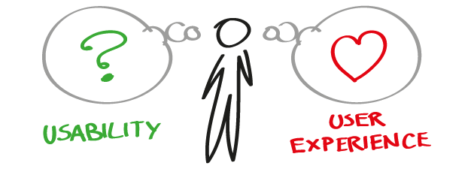

A
B
C
Virtual Agents, Avatars, ..

Slide 35
Design Principles
Generalizable abstractions for thinking about different aspects of design
The do’s and don’ts of interaction design
What to provide and what not to provide at the interface
Derived from a mix of theory-based knowledge, experience and common-sense
Virtual Agents, Avatars, ..

Slide 36
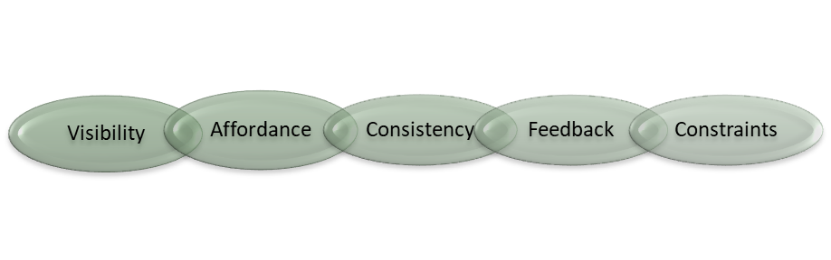
Design Principles
Visibility: can I see it?
Affordance: how do I use it?
Consistency: I think I have seen this before!
Feedback: what is it doing now?
Constraints: why can’t I do that?
Virtual Agents, Avatars, ..

Slide 37
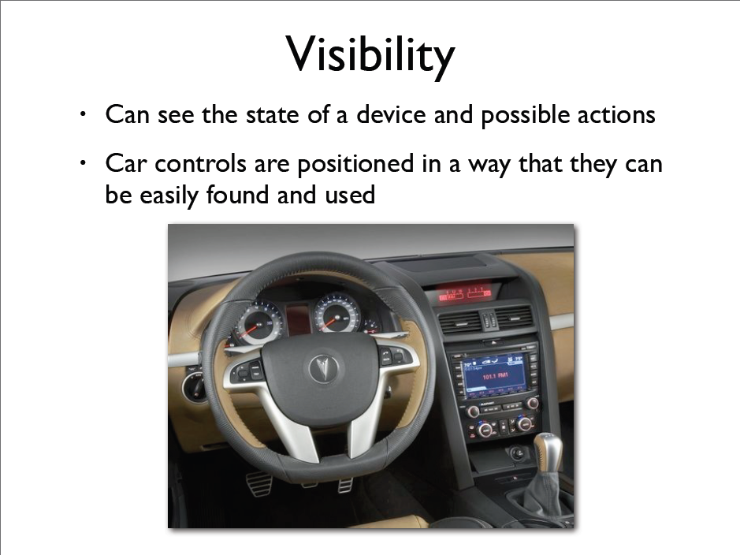
Design Principles Visibility
One of the most important design principles is visibility. Is achieved by placing the controls in a highly visible location.
Designing for visibility means that just by looking, users can see the possibilities for action.
Virtual Agents, Avatars, ..

Slide 38
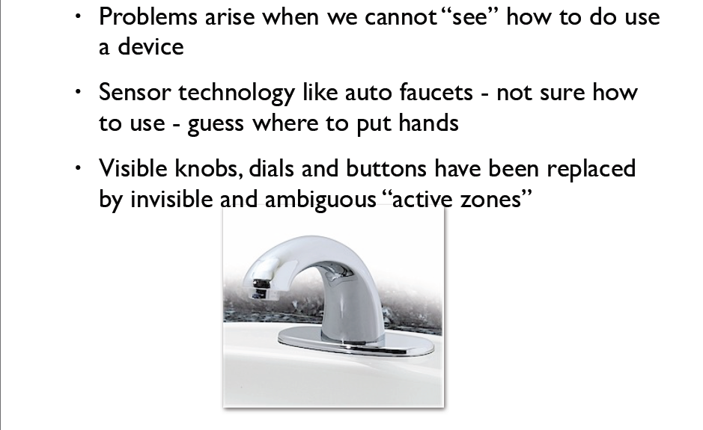
Design Principles Visibility
Virtual Agents, Avatars, ..

Slide 39
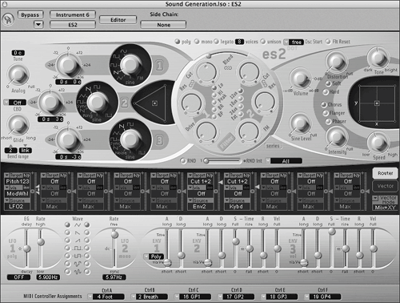
Design Principles Visibility
Virtual Agents, Avatars, ..

Slide 40
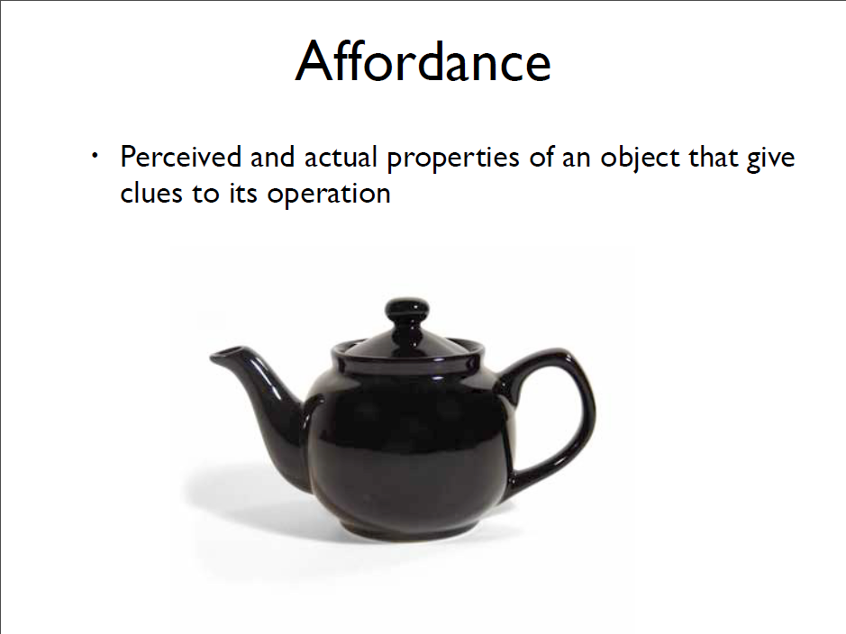
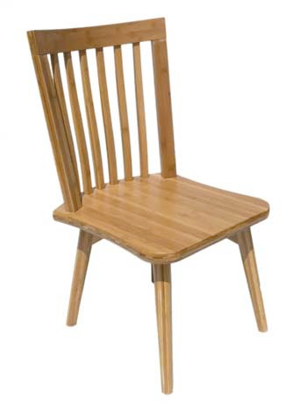
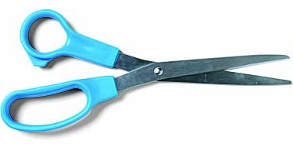
Virtual Agents, Avatars, ..

Slide 41
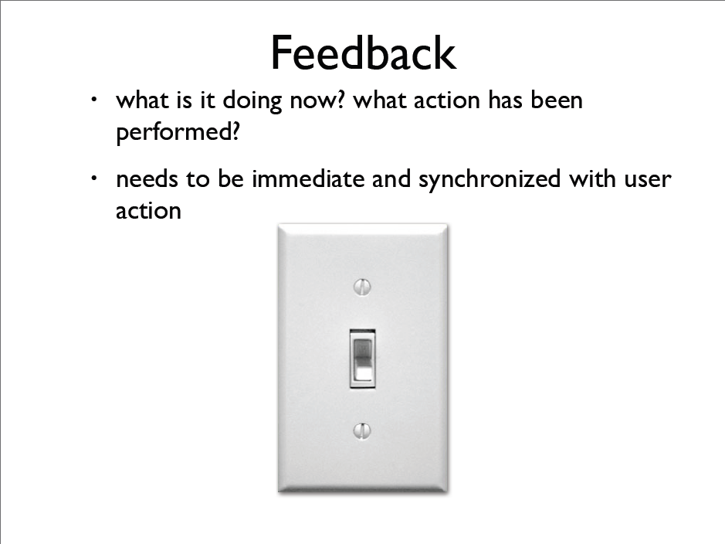
Virtual Agents, Avatars, ..

Slide 42
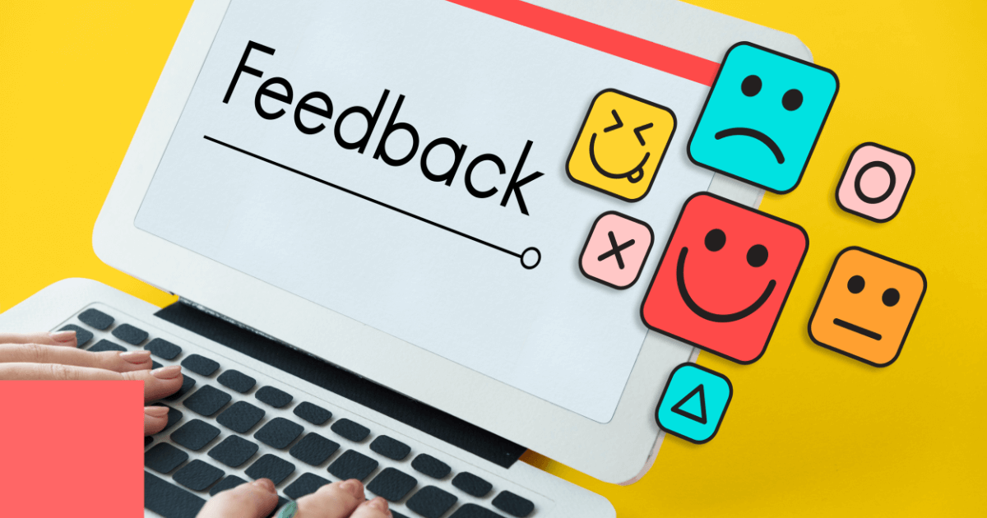
Design Principles Feedback
Sending information back to the user about what has been done
Includes sound, highlighting, animation and combinations of these
Virtual Agents, Avatars, ..

Slide 43


The properties of an object that limit the ways in which it can be used
Virtual Agents, Avatars, ..

Slide 44

Virtual Agents, Avatars, ..

Slide 45
Design Principles Consistency
Design interfaces to have similar operations and use similar elements for similar tasks
For example:
always use ctrl key plus first initial of the command for an operation – ctrl+C, ctrl+S, ctrl+O
Main benefit is consistent interfaces are easier to learn and use
Virtual Agents, Avatars, ..

Slide 46
Design Principles Consistency
What happens if there is more than one command starting with the same letter?
e.g. save, spelling, select, style
Have to find other initials or combinations of keys, thereby breaking the consistency rule
e.g. ctrl+S, ctrl+Sp, ctrl+shift+L
Increases learning burden on user, making them more prone to errors
Virtual Agents, Avatars, ..

Slide 47




Design Principles Consistency (Internal Vs External)
Internal consistency refers to designing operations to behave the same within an application
Difficult to achieve with complex interfaces
External consistency refers to designing operations, interfaces, etc., to be the same across applications and devices
Very rarely the case, based on different designer’s preference
Virtual Agents, Avatars, ..

Slide 48

Design Principles Constraints
Restricting the possible actions that can be performed
Helps prevent user from selecting incorrect options
Physical objects can be designed to constrain things
e.g. only one way you can insert a key into a lock
Restricting the possible actions that can be performed

Slide 49

Usability Principles
Virtual Agents, Avatars, ..

Slide 50
The Meaning of Design: What Design Is and Why It’s Important
What is design? Most people think that design is about making things look pretty – a decoration. Art. But design is as much an art as it is a science.
Cold and calculated process. Sometimes the detriment of pretty. Yet, the design is not allowed to fail. Design is for everyone and no one in particular. Website and mobile app design, as well as design in general, is a complex yet subtle process, it’s more than making things pretty
Design is a plan for arranging elements in such a way as best to accomplish a particular purpose.”
-Charles Eames, American designer, architect, and filmmaker

Slide 51

Meanwhile, the meaning of design depends on the context and can also mean a variety of other things. Design is the creation of an experience. It’s also the process of the said creation and how well it’s organized. On top of that, design is the result, i.e. the things we see, hear, and feel.
The purpose of design
Every type of design exists to solve problems. To see the problem and find a solution, designers rely on data. So the toolset of the designer is based on research, not prettification.
User interface design
A user interface is the main touchpoint of a designed product and a user. The UI design is about providing a user with the simplest and most efficient way to interact with a product. In that sense, a designer has to be well aware of the following three concepts of user interface design:
Condition or where the UI exists.
Content or what the UI looks like.
Context or who operates the UI.

Slide 52
Why UX design is important and what makes good design:
Good design will crack you up. User satisfaction is no longer a goal. It’s a default every design solution should be in line with. However, the fun and delight are the goals. The hard sell times are past. Modern design seduces and brings pleasure.
Good design will eat your money and make you feel good about it. Practical value is only a part of what people are willing to pay for. Another part is happiness. If your design makes people feel good, they will forgive you for technical issues and bad updates. How to make them happy? Be genuine and honest about your work. Listen. Change.
Good design feels like a person. For people to care, they have to empathize with something. If a product is designed in a way that favors everything, it favors nothing. You make a social impact by having a strong distinctive voice, promoting the right kind of values, and identifying with your audience. No matter what type of business you do, there has to be a human side to it.
Good design has meaning. Meaning connects people with objects. If that connection is meaningful, it will stay for years. The design should empower people to establish the connections they need to feel free, capable, and Enlighted.

Slide 53

Color in design
Colors are powerful symbols by which you live or die; they’re worth paying attention to.”
– Ben Hersh
What most people and, sadly, many designers know about color does not do it enough justice. Color is the first thing we’d notice but the last we’d understand. Colors can’t be explained and described unless seen. They can’t be changed but can be learned and used. This is how nature communicates with you, and that is why color is so important in design.

Slide 54
Animation in design
Illustrative. It can demonstrate the functionality or help understand it better.
Amusing. Value can be expressed in many ways. Positivity is one of them.
Familiar. We expect certain reactions from certain actions. Animation familiarizes.
Engaging. We tend to follow patterns and animation is a great source of those.

Slide 55

Design thinking and wicked problems
Every day, we are confronted with problems–small and large scale. Design thinking provides a systematic approach to solving these problems. Formally, design thinking refers to the diverse and interrelated approaches, techniques, and tricks to scientifically addressing the problems we face individually and collectively.
The term “wicked problem” was first coined by Horst Rittel, design theorist and professor of design methodology at the Ulm School of Design, Germany.
In 1973, design theorists Horst Rittel and Melvin M. Webber used the term “wicked problem” to refer to problems that are difficult to define and inherently unsolvable.

Slide 56
They suggested the following 10 characteristics of wicked problems:
A lack of definitive formulation.
No stopping rule that determines when a solution has been found.
Good or bad solutions rather than true or false solutions.
Lack of immediate and ultimate tests of solutions.
Solutions are “one-shot” operations rather than trial and error.
Lack of criteria that indicate all solutions have been identified.
The uniqueness of every wicked problem.
Any wicked problem could be viewed as a symptom of another problem.
Any discrepancies in wicked problem can be explained in multiple ways.
Planners have no right to be wrong in that they are responsible for outcomes that result from the actions they take.
Examples of wicked problems that have been addressed in scholarly literature include poverty, urban renewal, school curriculum design, education, environmental and natural resources policy.

Slide 57

Examples of wicked problems
Global heating
Is it unique and / or novel?
Yes—it is unique in the sense that we don’t face any problems similar to global heating as a whole. However, it has been talked about since at least the 1980s, so it is no longer a novel problem.
Is it difficult or impossible to solve?
Yes—it is certainly difficult to solve. Whether or not it is impossible to solve remains to be seen.
Is it characterized by incomplete factors and / or complex interdependencies?
Yes—an example of an incomplete factor is the potential unavailability of reliable data about how much any country has reduced its CO₂ emissions, due to the political, economic, and social pressure to show significant reductions.
Is it subject to contradictory evidence?
The scientific consensus that the climate is warming and this is being caused by humans is not subject to contradictory evidence to any significant degree—as of 2019, 99% of the scientific evidence supported it.
Is it dependent on multiple stakeholders with different interests?
Yes—not only do individual nations, groups of nations, industries, and unions have different interests, each of those contains multiple stakeholders with different agendas and interests, such as political parties, lobby groups, think-tanks, big business, etc.
Is it a wicked problem?
Yes—global heating clearly meets four of the five criteria to be classified as a wicked problem.

Slide 58
What are some examples of wicked problems?
Some examples of wicked problems are earthquakes, death, disease, and economic problems. Political instability and floods are also good examples.
What is an example of a tame problem?
An example of a tame problem is a printer running out of paper. The solution would be to add more paper to the machine.
Can wicked problems be solved?
Wicked problems cannot be solved. It is very difficult to understand a wicked problem and formulate a solution to solve the problem.
Is homelessness a wicked problem?
Definition of homelessness
Experiencing homelessness means not having stable, safe and adequate housing, nor the means and ability of obtaining it.
Homelessness is a wicked problem. This is because it is very difficult to understand why it happens and to determine a suitable solution to end it and prevent it from happening.

Slide 59
Exercise and Case Study –
Identify problems around us requiring design solutions Or problems solved using design.
Task
Visit to Nearby 3 different Bank ATM. Identify Problems in USER Interface and Discuss Solution
Virtual Agents, Avatars, ..

Slide 60
THANK YOU
Virtual Agents, Avatars, ..

